Slide 1
Heat Transfer (CH21204)
Conduction and Radiation
Class –IV
Radiation Heat Transfer between black and non-black surfaces

Slide 2
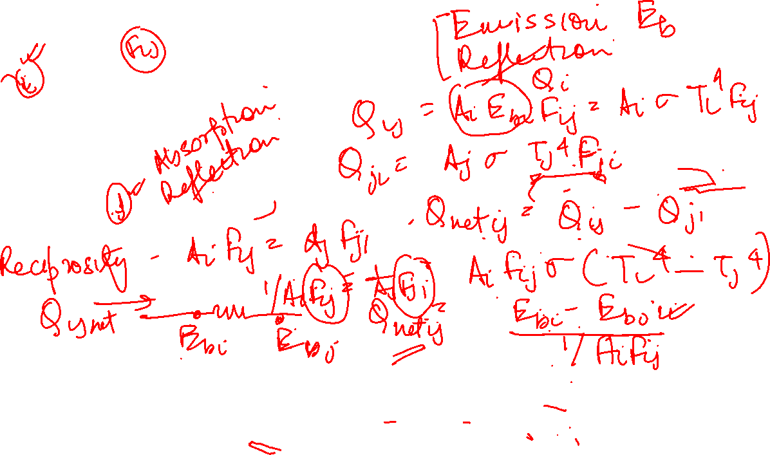
Radiant heat exchange between two black surfaces
Qnet-ij =
Equivalent Radiation Network for two surfaces that see each other and nothing else

Slide 3
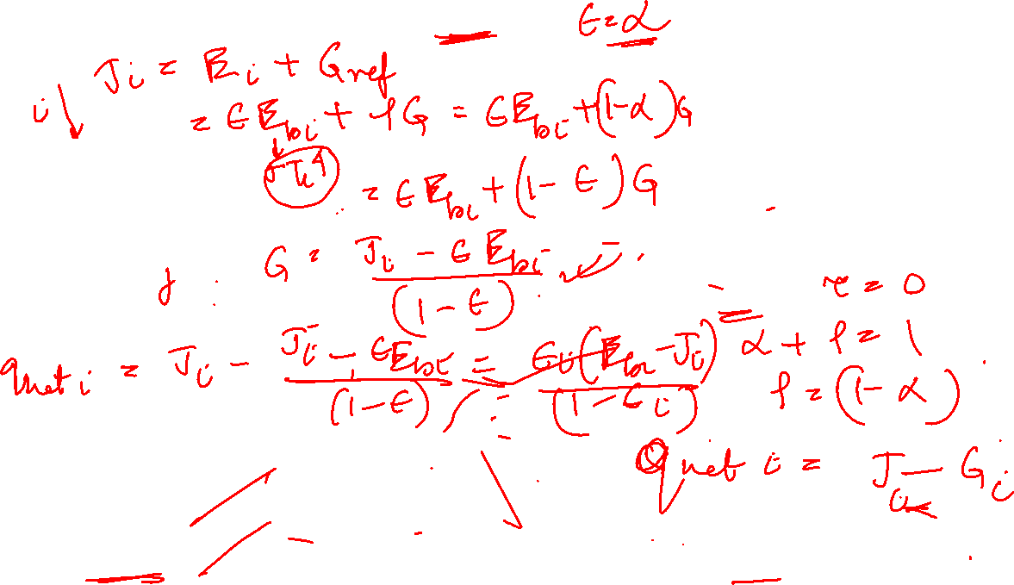
Radiant heat exchange between two gray surfaces
All surfaces diffuse and uniform in temperature
Emissive and reflective properties constant over all surfaces.
Radiosity J and irradiation G uniform throughout each surface
Opaque
Radiosity (W/m²) of a surface accounts for all radiant energy leaving surface
Net radiative flux from surface (W/m²) = Outgoing radiation - Incoming radiation

Slide 4
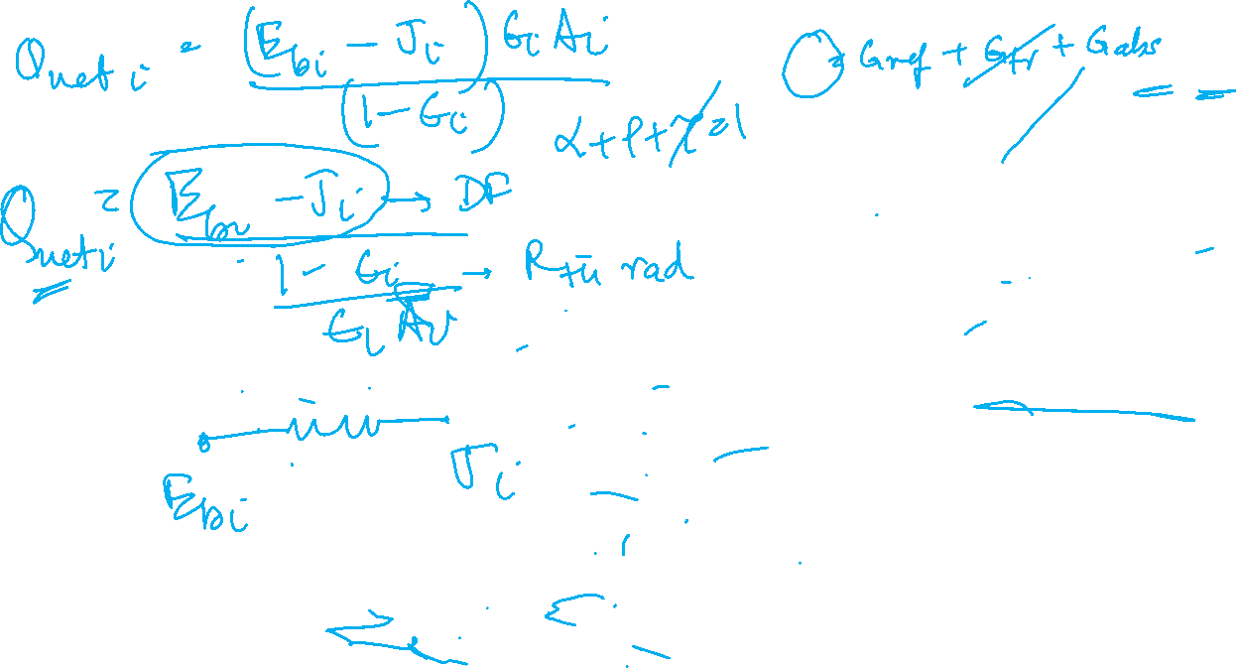
Heat Exchange between non-black bodies
Surface Energy Balance for Opaque Material
All surfaces diffuse and uniform in temperature
Emissive and reflective properties constant over all surfaces.
Radiosity J and irradiation G uniform throughout each surface
Opaque
Radiosity (W/m²) of a surface, J accounts for all radiant energy leaving surface
Net radiative flux from surface (W/m²) = Outgoing radiation - Incoming radiation

Slide 5
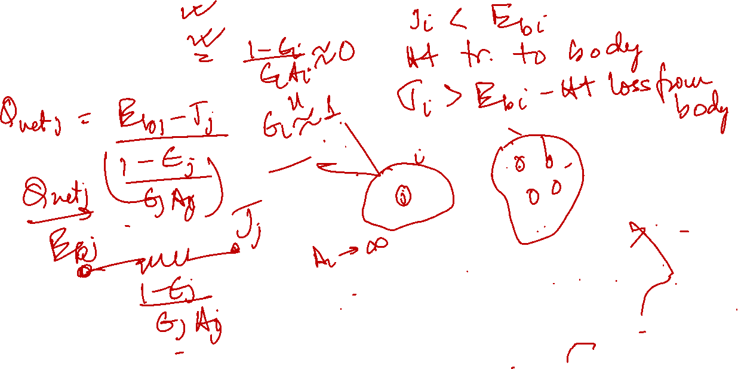
Heat Exchange between gray, opaque, diffused surfaces in an enclosure
Salient observations from Equation –
(i)
(ii)
Surface which is large relative to all other surfaces under consideration can be treated as a blackbody
Physical Explanation ??

Slide 6
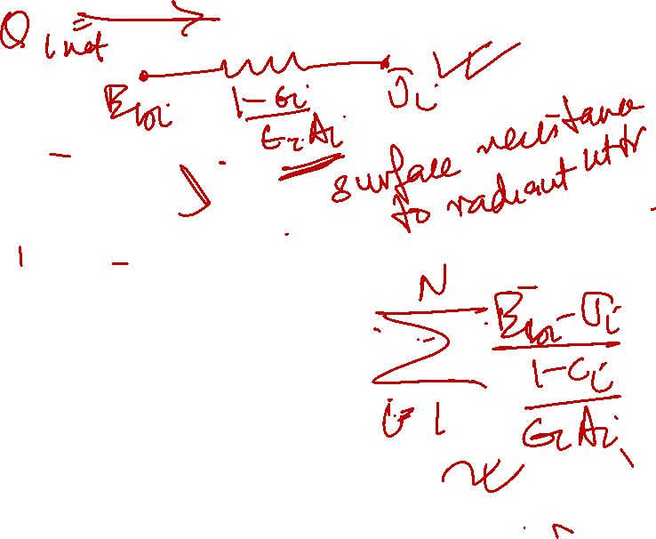
Heat Exchange between non-black bodies
Equivalent Radiation Circuit
For each surface net energy transfer =
For N surfaces,
Surface Energy Balance for Opaque Material

Slide 7
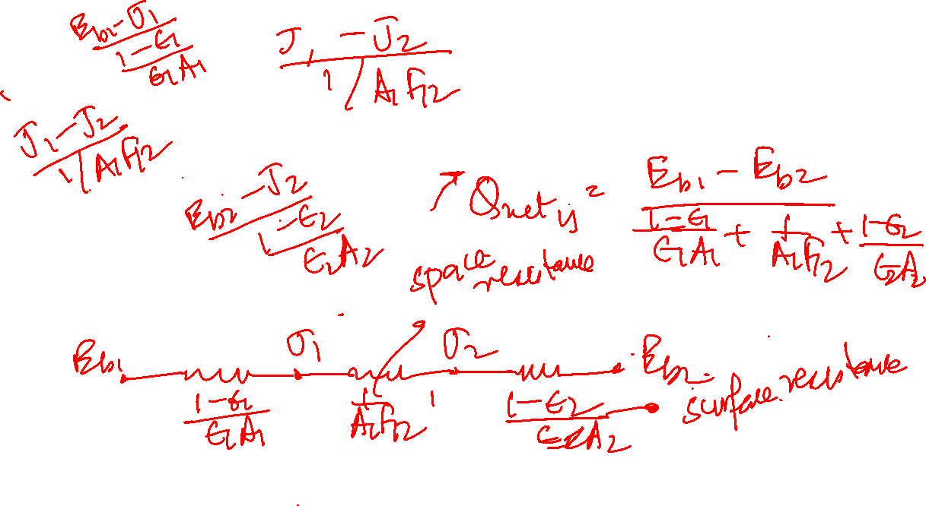
Radiant heat exchange between two gray surfaces
All surfaces diffuse and uniform in temperature
Emissive and reflective properties constant over all surfaces.
Radiosity J and irradiation G uniform throughout each surface
Opaque
Equivalent Radiation Network for two surfaces that see each other and nothing else
Radiosity (W/m²) of a surface accounts for all radiant energy leaving surface
Net radiative flux from surface (W/m²) = Outgoing radiation - Incoming radiation

Slide 8

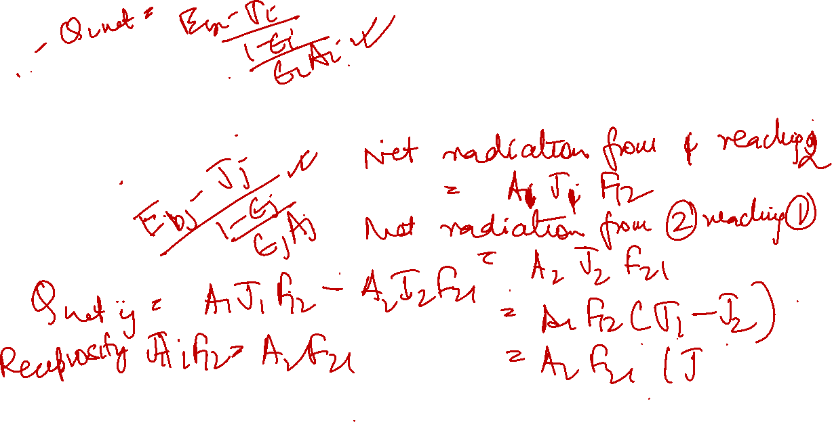
Radiant heat exchange between two gray surfaces
All surfaces diffuse and uniform in temperature
Emissive and reflective properties constant over all surfaces.
Radiosity J and irradiation G uniform throughout each surface
Opaque
Qnet-ij =
Radiosity (W/m²) of a surface accounts for all radiant energy leaving surface
Net radiative flux from surface (W/m²) = Outgoing radiation - Incoming radiation

Slide 9
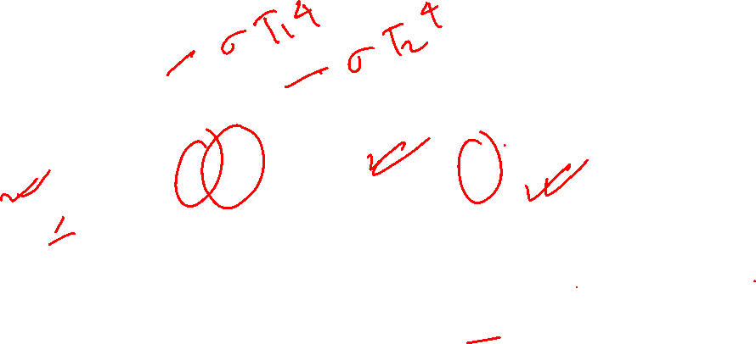
Equivalent Radiation Network for two surfaces that see each other and nothing else

Slide 10
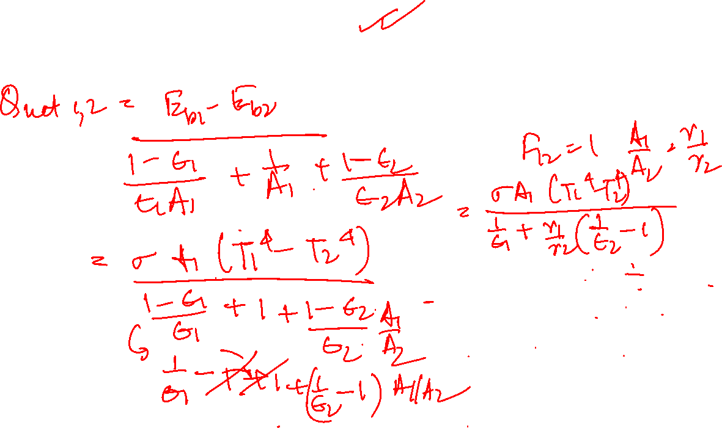
Two long concentric cylinders

Slide 11
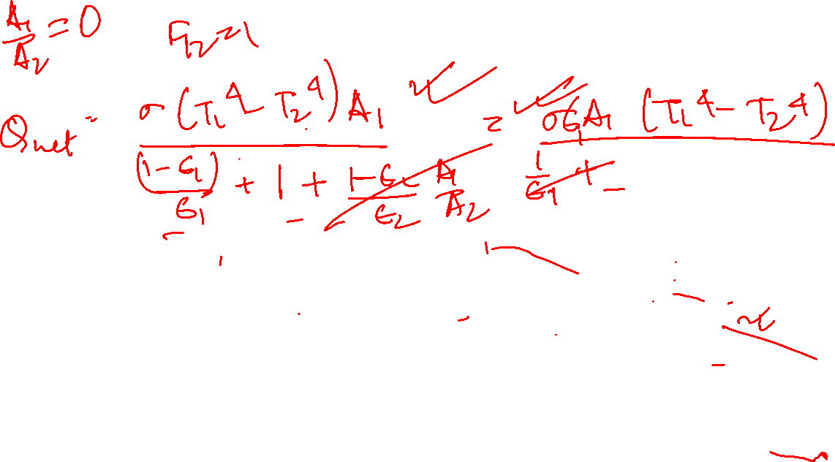
Hot object in a large room

Slide 12
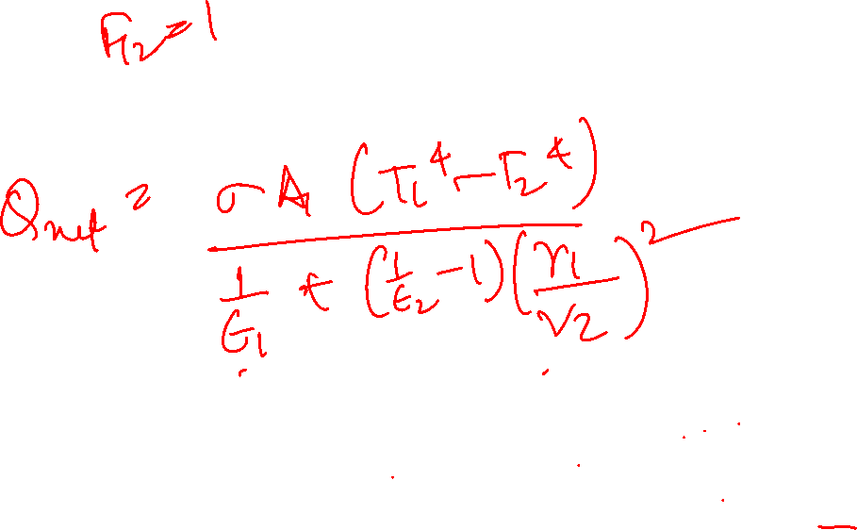
Concentric Spheres

Slide 13
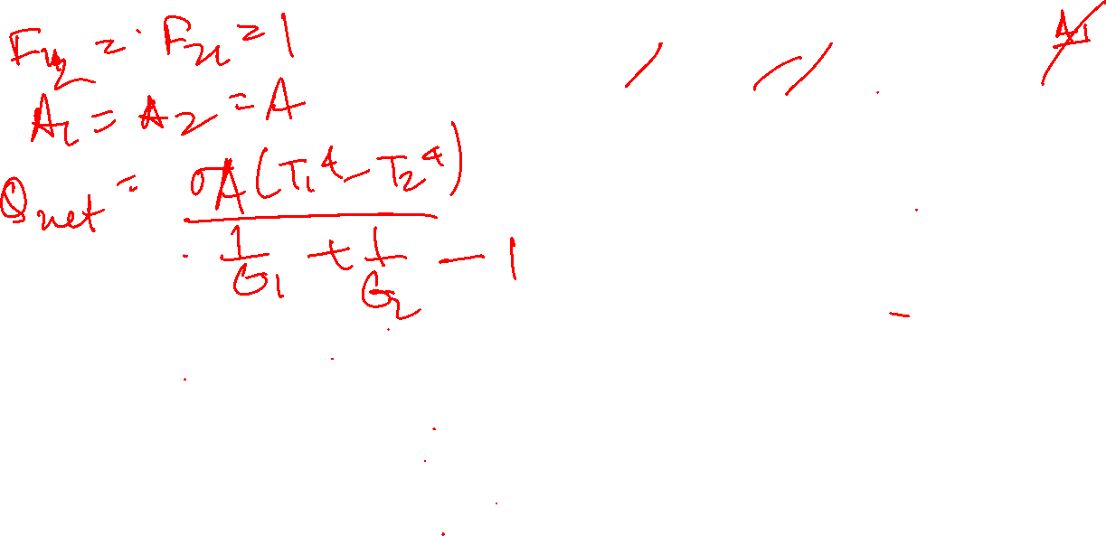
Infinite Parallel Planes

Slide 14
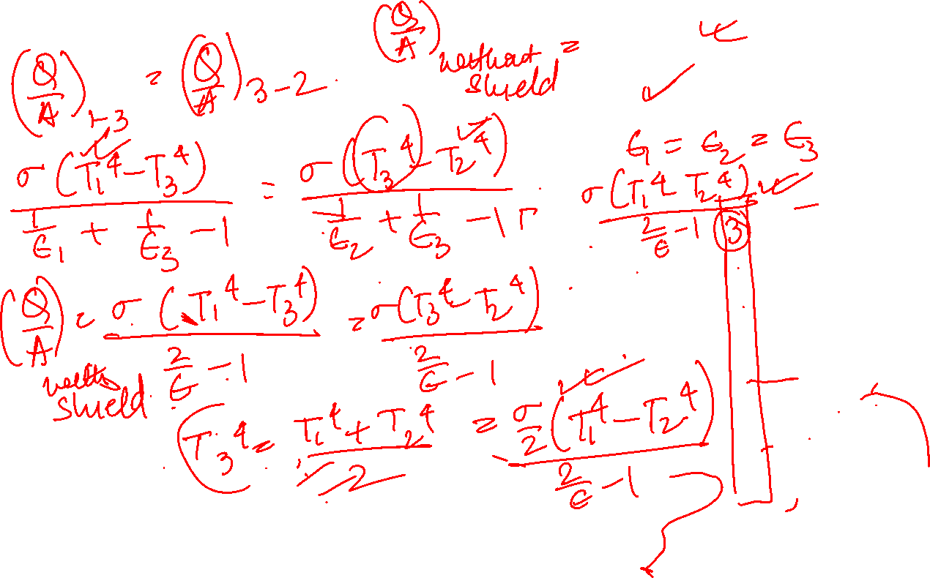
Radiation Shield

Slide 15
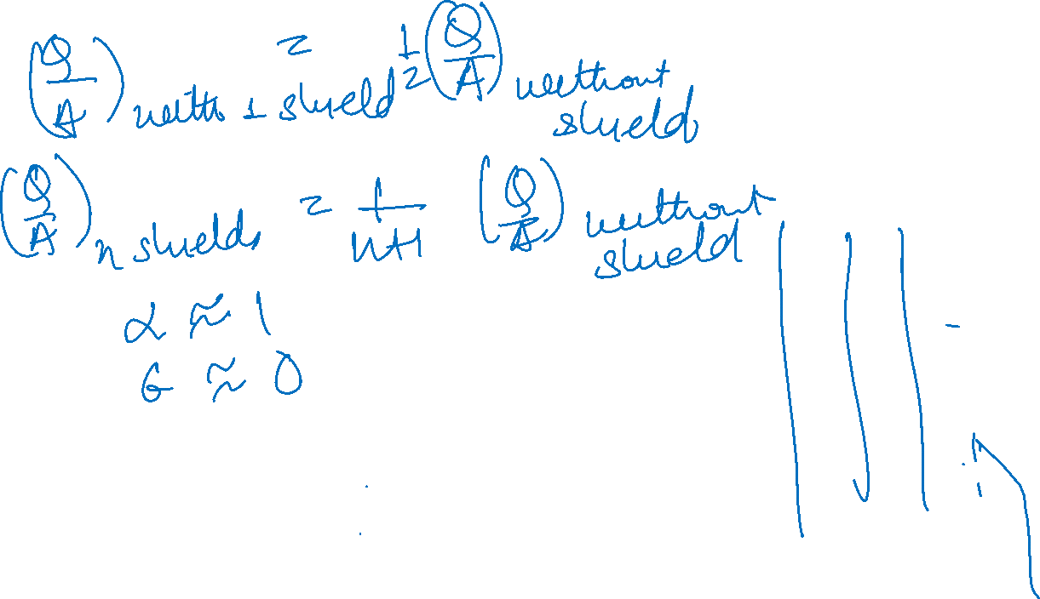
Radiation Shield

Slide 16
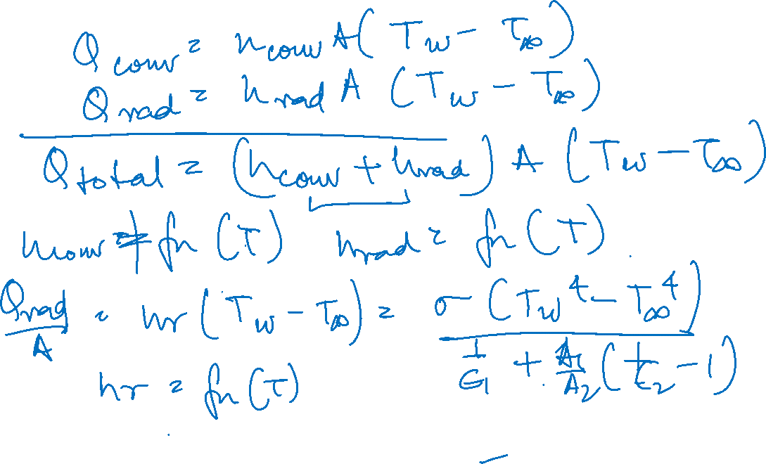
Radiation heat transfer coefficient

Slide 17
Radiation Network for three surfaces that see each other and nothing else
Kirchoff’s current Law - Sum of the currents entering a node is zero

